Slide 1


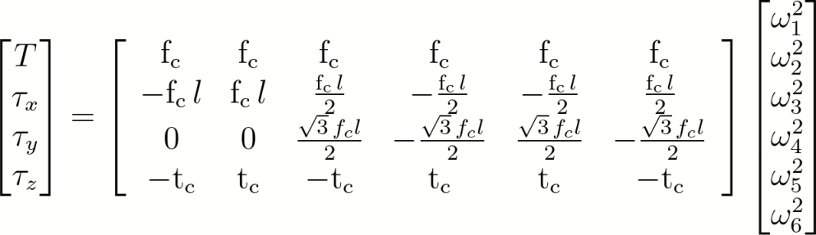
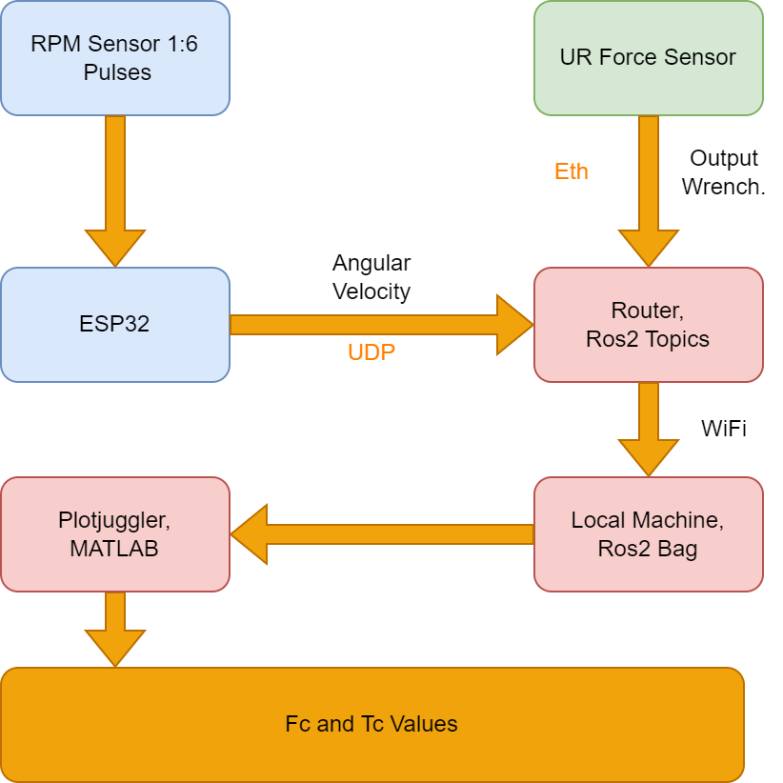
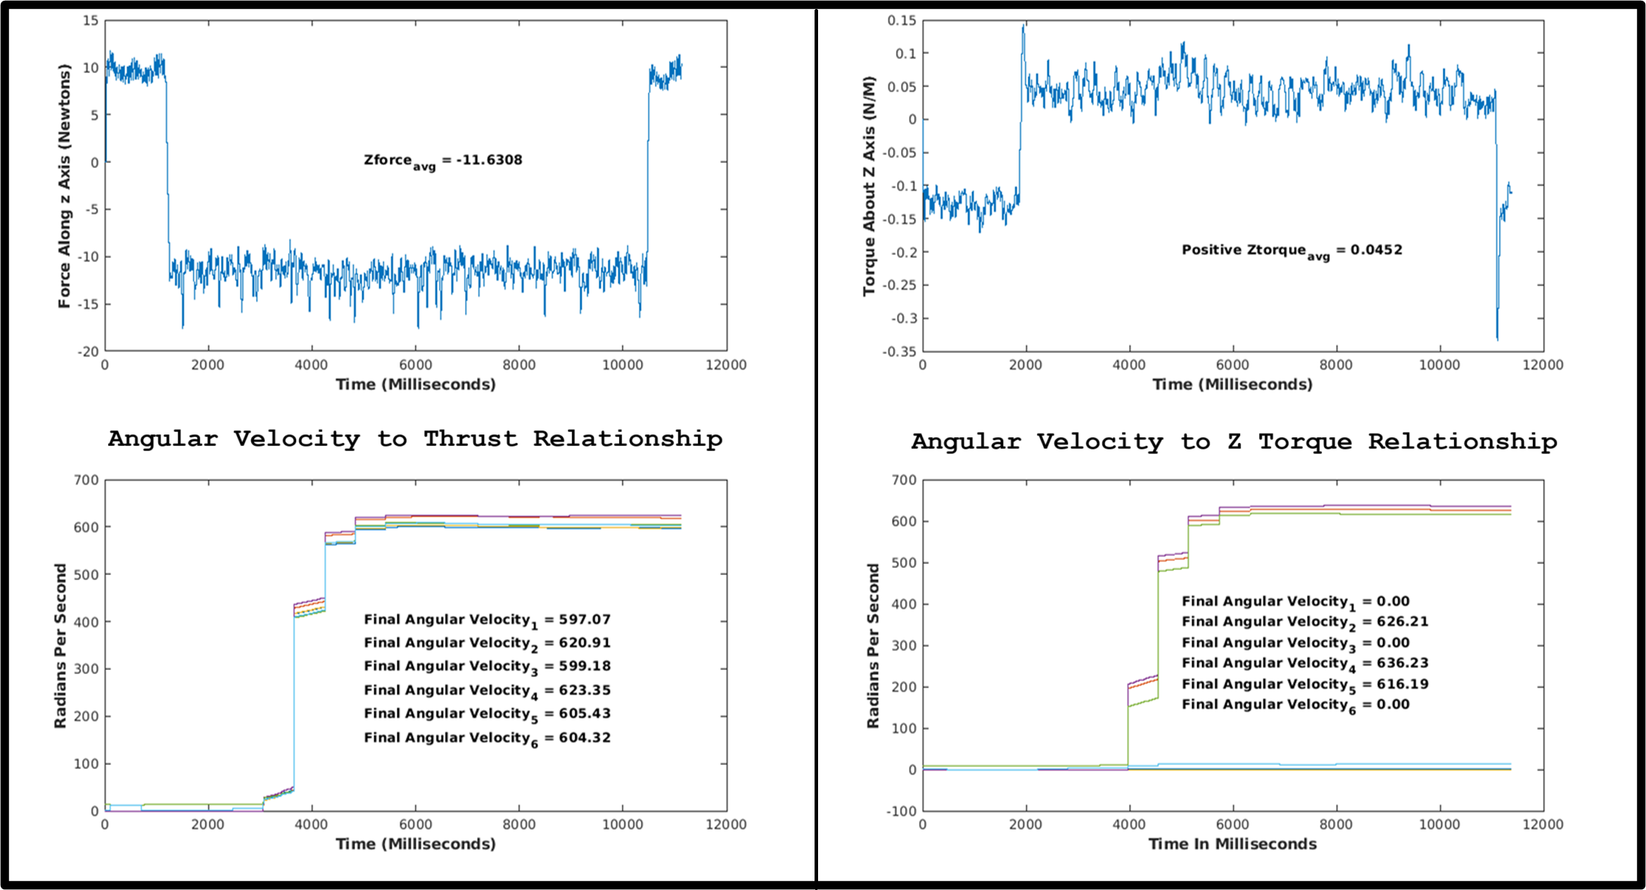
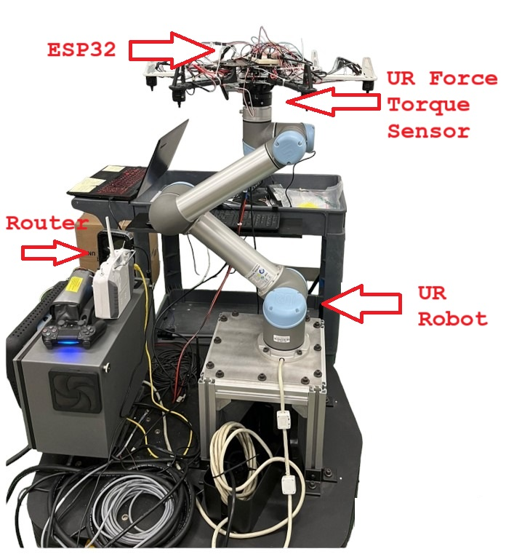
Real-Time Force and Moment Feedback of a Hexarotor Drone
Richard Kovalcik, Engineering(Robotics)
Mentor: Wenlong Zhang, Associate Professor
School of Manufacturing Systems and Networks
Research Questions: Can the angular velocity and output wrench of a hexarotor drone be measured in real time? Can this data be used to create a model for precise environment interactions?
Research Statement
Control Allocation Matrix
Research Application
Methodology
DC motors in multirotor drones are typically controlled via Pulse Width Modulation signals. These signals, however, spin the motors at different speeds with different battery percentages. This leads to difficulties in controlling motor forces while flying the drone. This research models the correlation between motor angular velocity and thrust, thereby resolving this issue.
The calculated Fc and Tc values will allow a drone operator to exert specific forces and torques on objects in real time. The gathered angular velocity of each motor can be plugged into the control allocation matrix with the Fc and Tc values to give the drones real time wrench output.
Calculated Fc and Tc Values
Fc = 0.0090: Sample Size (2)
Tc = 00002406: Sample Size (6)
Results
Data Collection and Processing
The plots below display the relationship between individual motor angular velocities and their corresponding output wrench.
Test data was formatted into a csv and imported into MATLAB. The desired arrays were cleaned up using linear interpolation. The mean of the data points within the testing range was calculated to find the average wrench output of each test. MATLAB’s symbolic toolbox was used to solve for the Fc and Tc constants of each test. The mean of these constants was then taken to provide the final Fc and Tc values. These values were successfully tested by predicting Tx and Ty values at different motor speeds.
Hardware
Conclusions
The ability to measure the RPM of the motors permits closed-loop control of the motor thrusts. This replaces the existing open-loop control that varies depending on the battery level.
Acknowledgements
I thank Yizhuang Garrard and Dr. Wenlong Zhang for their guidance and advice on this project.

